Slide 1

DATA ANALYTICS
Unit 2:Distance and Similarity Measures
Mamatha H R
Department of Computer Science and Engineering

Slide 2
DATA ANALYTICS
Similarity and Dissimilarity Measures
Similarity and dissimilarity are important because they are used by a number of data mining, data analytics and machine learning techniques, such as clustering, nearest neighbor classification, and anomaly detection.
In many cases, the initial data set is not needed once these similarities or dissimilarities have been computed.
Such approaches can be viewed as transforming the data to a similarity (dissimilarity) space and then performing the analysis.

Slide 3
DATA ANALYTICS
Similarity and Dissimilarity Measures
Similarity measure
Numerical measure of how alike two data objects are.
Is higher when objects are more alike.
Often falls in the range [0,1]
Dissimilarity measure
Numerical measure of how different two data objects are
Lower when objects are more alike
Minimum dissimilarity is often 0
Upper limit varies
Proximity refers to a similarity or dissimilarity

Slide 4
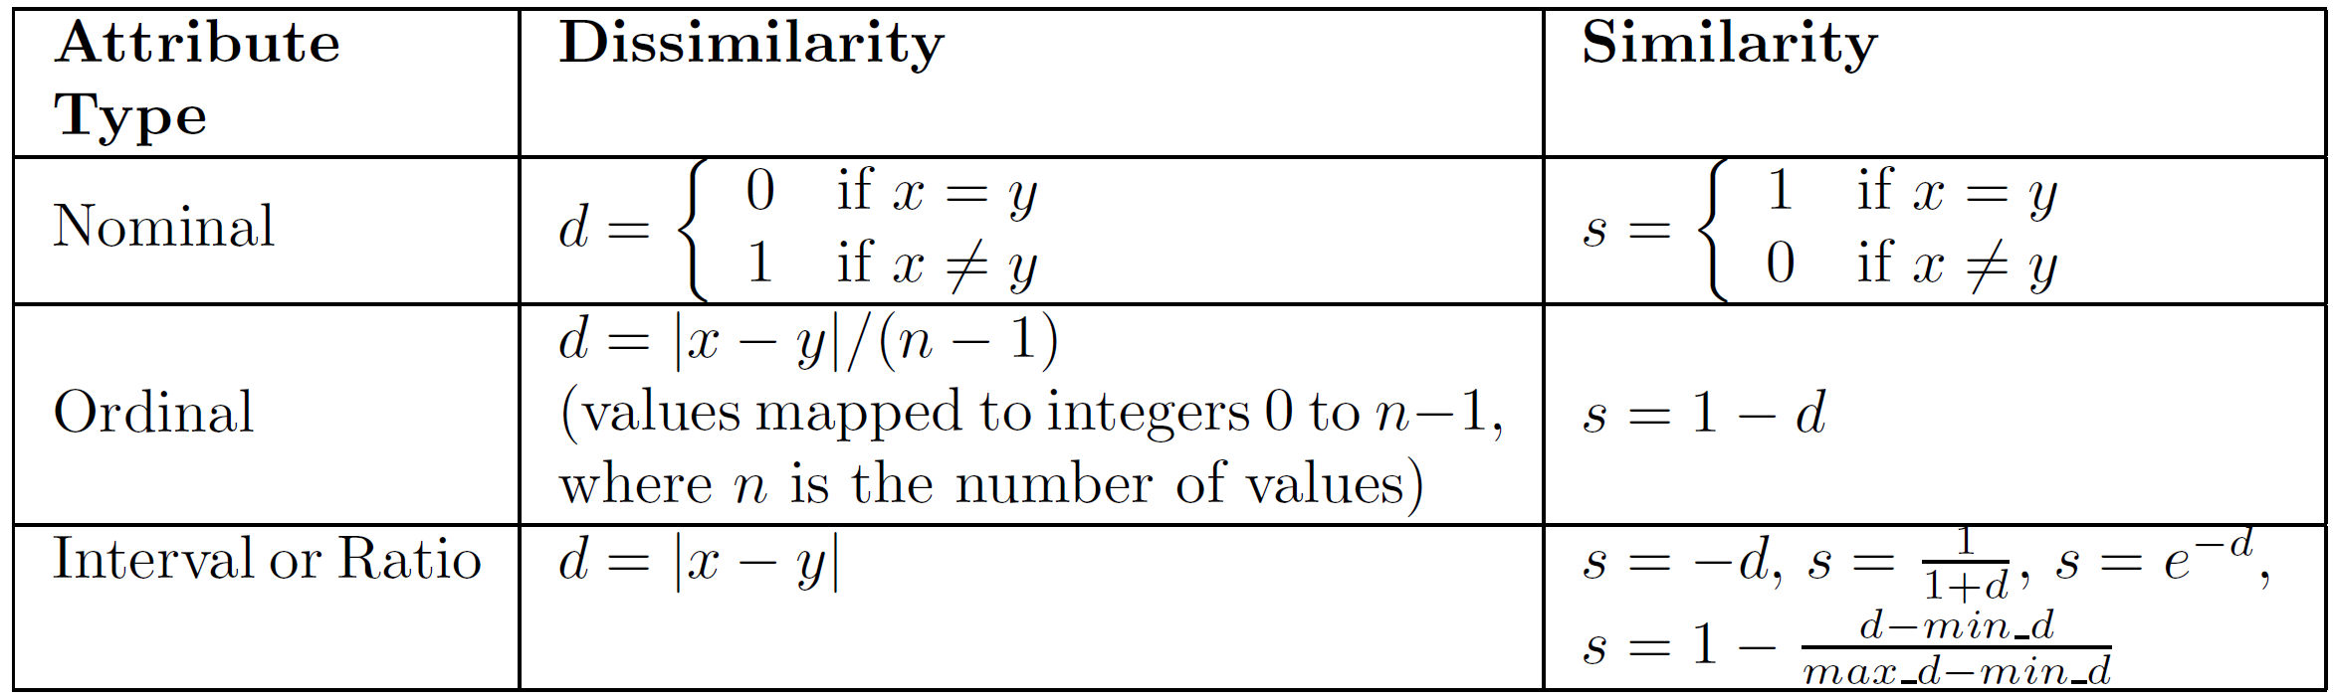
DATA ANALYTICS
Similarity/Dissimilarity for Simple Attributes
The following table shows the similarity and dissimilarity between two objects, x and y, with respect to a single, simple attribute.

Slide 5
DATA ANALYTICS
Common Properties of a Distance
Distances, such as the Euclidean distance, have some well known properties.
d(x, y) ≥ 0 for all x and y and d(x, y) = 0 only if x = y. (Positive definiteness)
d(x, y) = d(y, x) for all x and y. (Symmetry)
d(x, z) ≤ d(x, y) + d(y, z) for all points x, y, and z. (Triangle Inequality)
where d(x, y) is the distance (dissimilarity) between points (data objects), x and y.
A distance that satisfies these properties is a metric

Slide 6
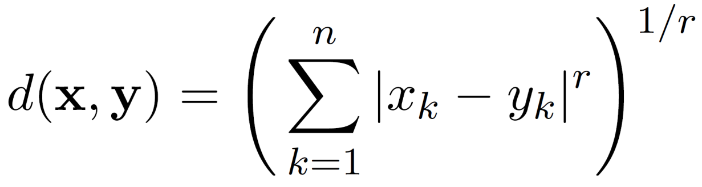
DATA ANALYTICS
Minkowski Distance
Minkowski Distance is a generalization of Euclidean Distance
Where r is a parameter, n is the number of dimensions (attributes) and x_{k} and y_{k} are, respectively, the k^{th} attributes (components) or data objects x and y.

Slide 7
DATA ANALYTICS
Minkowski Distance: Examples
r = 1. City block (Manhattan, taxicab, L₁ norm) distance.
A common example of this for binary vectors is the Hamming distance, which is just the number of bits that are different between two binary vectors
r = 2. Euclidean distance
r → ∞. “supremum” (L_{max} norm, L∞ norm) distance.
This is the maximum difference between any component of the vectors
Do not confuse r with n, i.e., all these distances are defined for all numbers of dimensions.

Slide 8
DATA ANALYTICS
Minkowski Distance
Distance Matrix

Slide 9
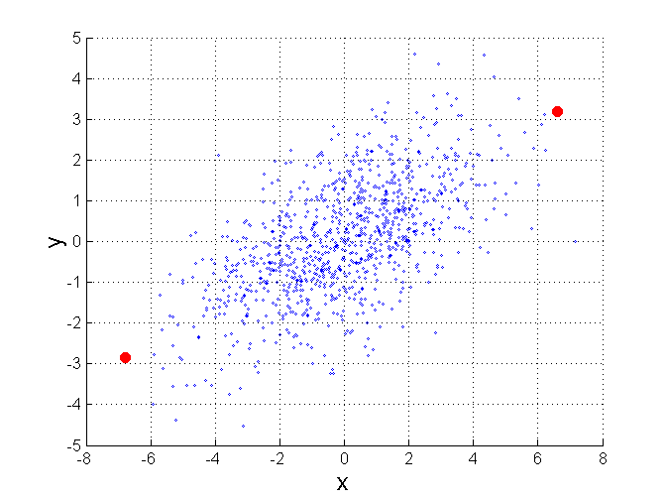
DATA ANALYTICS
Mahalanobis Distance
$$\left(mahalanobis\left(x,y\right)\right)2={ (x−y)}^{T}Ʃ^{−1}(x−y)$$
For red points, the Euclidean distance is 14.7, Mahalanobis distance is 6.

Slide 10
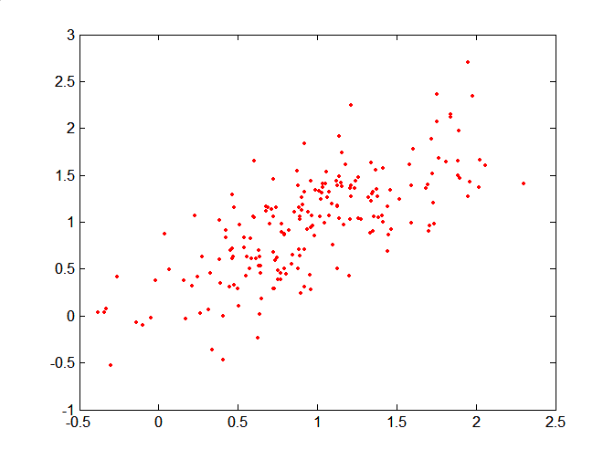
DATA ANALYTICS
Mahalanobis Distance
Covariance Matrix:
A: (0.5, 0.5)
B: (0, 1)
C: (1.5, 1.5)
Mahal(A,B) = 5
Mahal(A,C) = 4

Slide 11
DATA ANALYTICS
Common Properties of a Similarity
Similarities, also have some well known properties.
s(x, y) = 1 (or maximum similarity) only if x = y. (does not always hold, e.g., cosine)
s(x, y) = s(y, x) for all x and y. (Symmetry)
where s(x, y) is the similarity between points (data objects), x and y.

Slide 12
DATA ANALYTICS
Similarity Between Binary Vectors
Common situation is that objects, x and y, have only binary attributes
Simple Matching and Jaccard Coefficients
SMC = number of matches / number of attributes
= (f₁₁ + f₀₀) / (f₀₁ + f₁₀ + f₁₁ + f₀₀)
J = number of 11 matches / number of non-zero attributes
= (f₁₁) / (f₀₁ + f₁₀ + f₁₁)

Slide 13
DATA ANALYTICS
SMC versus Jaccard: Example
x = 1 0 0 0 0 0 0 0 0 0
y = 0 0 0 0 0 0 1 0 0 1
f₀₁ = 2 (the number of attributes where x was 0 and y was 1)
f₁₀ = 1 (the number of attributes where x was 1 and y was 0)
f₀₀ = 7 (the number of attributes where x was 0 and y was 0)
f₁₁ = 0 (the number of attributes where x was 1 and y was 1)
SMC = (f₁₁ + f₀₀) / (f₀₁ + f₁₀ + f₁₁ + f₀₀)
= (0+7) / (2+1+0+7) = 0.7
J = (f₁₁) / (f₀₁ + f₁₀ + f₁₁) = 0 / (2 + 1 + 0) = 0

Slide 14
DATA ANALYTICS
Cosine Similarity
If d₁ and d₂ are two document vectors, then
cos( d₁, d₂ ) = <d₁,d₂> / ||d₁|| ||d₂|| ,
where <d₁,d₂> indicates inner product or vector dot product of vectors, d₁ and d_{2,} and || d || is the length of vector d.
Example:
d₁ = 3 2 0 5 0 0 0 2 0 0
d₂ = 1 0 0 0 0 0 0 1 0 2
<d₁, d2> = 3*1 + 2*0 + 0*0 + 5*0 + 0*0 + 0*0 + 0*0 + 2*1 + 0*0 + 0*2 = 5
|| d₁ || = (3*3+2*2+0*0+5*5+0*0+0*0+0*0+2*2+0*0+0*0)^{0.5} = (42) ^{0.5} = 6.481
|| d₂ || = (1*1+0*0+0*0+0*0+0*0+0*0+0*0+1*1+0*0+2*2) ^{0.5} = (6) ^{0.5} = 2.449
cos(d₁, d₂ ) = 0.3150

Slide 15
DATA ANALYTICS
Extended Jaccard Coefficient (Tanimoto), Cosine Similarity
Variation of Jaccard for continuous or count attributes
Reduces to Jaccard for binary attributes

Slide 16
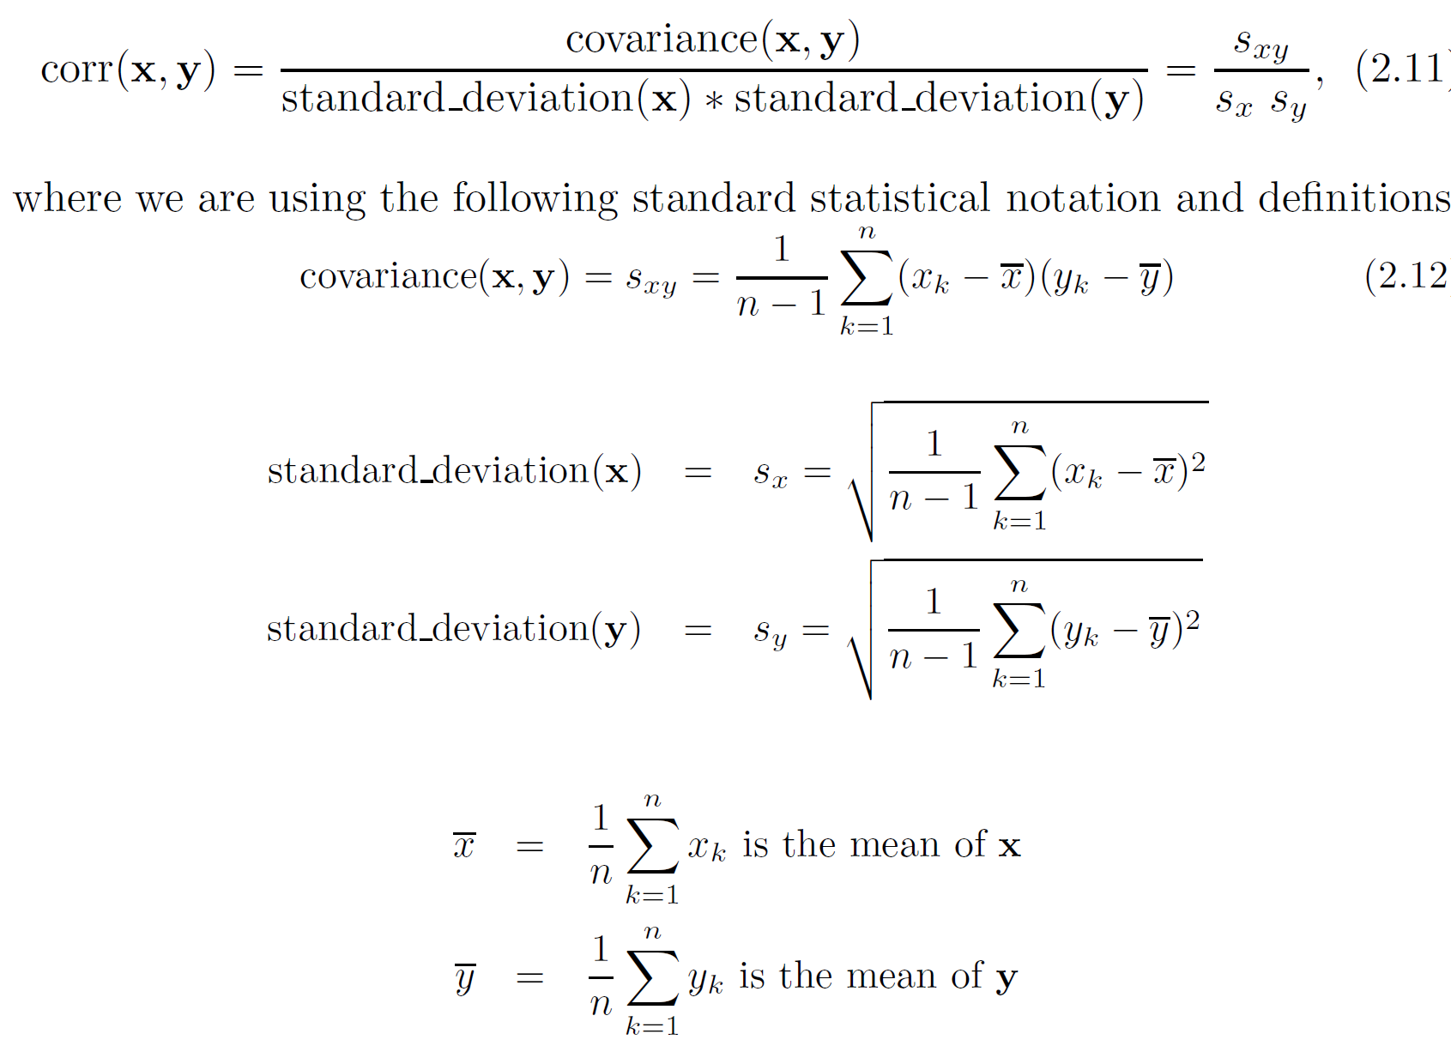
DATA ANALYTICS
Correlation measures the linear relationship between objects

Slide 17
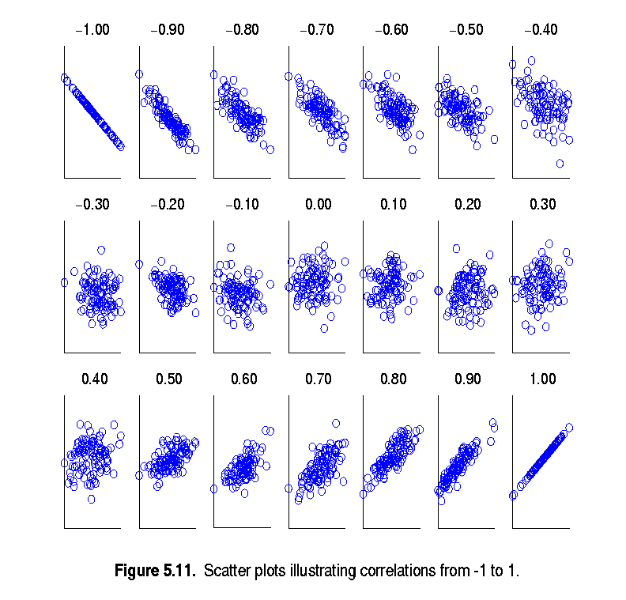
DATA ANALYTICS
Visually Evaluating Correlation
Scatter plots showing the similarity from –1 to 1.

Slide 18
DATA ANALYTICS
Drawback of Correlation
x = (-3, -2, -1, 0, 1, 2, 3)
y = (9, 4, 1, 0, 1, 4, 9)
y_{i} = x_{i}²
mean(x) = 0, mean(y) = 4
std(x) = 2.16, std(y) = 3.74
corr = (-3)(5)+(-2)(0)+(-1)(-3)+(0)(-4)+(1)(-3)+(2)(0)+3(5) / ( 6 * 2.16 * 3.74 )
= 0

Slide 19
DATA ANALYTICS
Comparison of Proximity Measures
Domain of application
Similarity measures tend to be specific to the type of attribute and data
Record data, images, graphs, sequences, 3D-protein structure, etc. tend to have different measures
However, one can talk about various properties that you would like a proximity measure to have
Symmetry is a common one
Tolerance to noise and outliers is another
Ability to find more types of patterns?
Many others possible
The measure must be applicable to the data and produce results that agree with domain knowledge

Slide 20
DATA ANALYTICS
General Approach for Combining Similarities
Sometimes attributes are of many different types, but an overall similarity is needed.
1: For the k^{th} attribute, compute a similarity, s_{k}(x, y), in the range [0, 1].
2: Define an indicator variable, δ_{k}, for the k^{th} attribute as follows:
δ_{k} = 0 if the k^{th} attribute is an asymmetric attribute and
both objects have a value of 0, or if one of the objects has a missing value for the kth attribute
δ_{k} = 1 otherwise
3. Compute

Slide 21
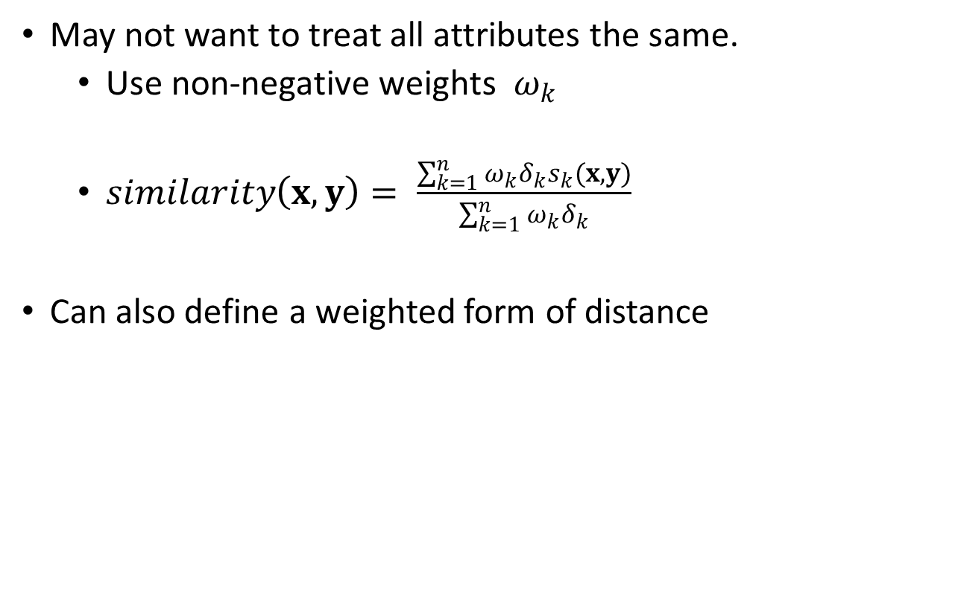
DATA ANALYTICS
Using Weights to Combine Similarities
May not want to treat all attributes the same.
Use non-negative weights $ω_{k}$
$similarity\left(x,y\right)= \frac{\sum_{k=1}^{n}{ω_{k}δ_{k}s_{k}(x,y)}}{\sum_{k=1}^{n}{ω_{k}δ_{k}}}$
Can also define a weighted form of distance

Slide 22
DATA ANALYTICS
Density
Measures the degree to which data objects are close to each other in a specified area
The notion of density is closely related to that of proximity
Concept of density is typically used for clustering and anomaly detection
Examples:
Euclidean density
Euclidean density = number of points per unit volume
Probability density
Estimate what the distribution of the data looks like
Graph-based density
Connectivity

Slide 23
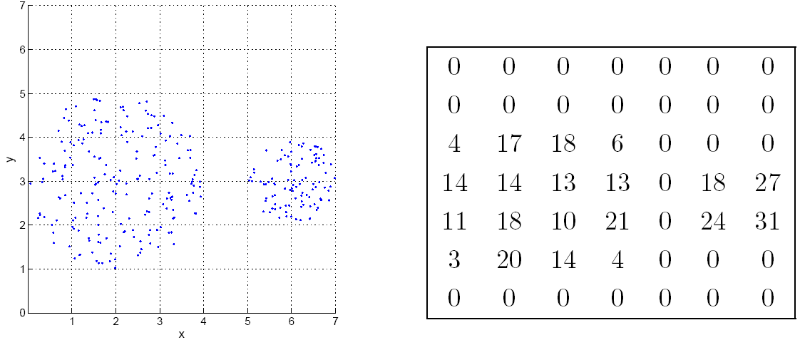
DATA ANALYTICS
Euclidean Density: Grid-based Approach
Simplest approach is to divide region into a number of rectangular cells of equal volume and define density as # of points the cell contains

Slide 24
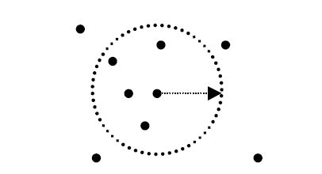
DATA ANALYTICS
Euclidean Density: Center-Based
Euclidean density is the number of points within a specified radius of the point
Illustration of center-based density.

Slide 25
DATA ANALYTICS
Exercise
Mention and explain the different distance measures.
For each of the distance measure, find out an application and explore how it is used in that application.

Slide 26
DATA ANALYTICS
References
(R1) Data Mining: Concepts and Techniques by Jiawei Han, Micheline Kamber and Jian Pei
Introduction to Data Mining, Tan, Steinbach, Kumar, 2nd Edition

